Slide 1
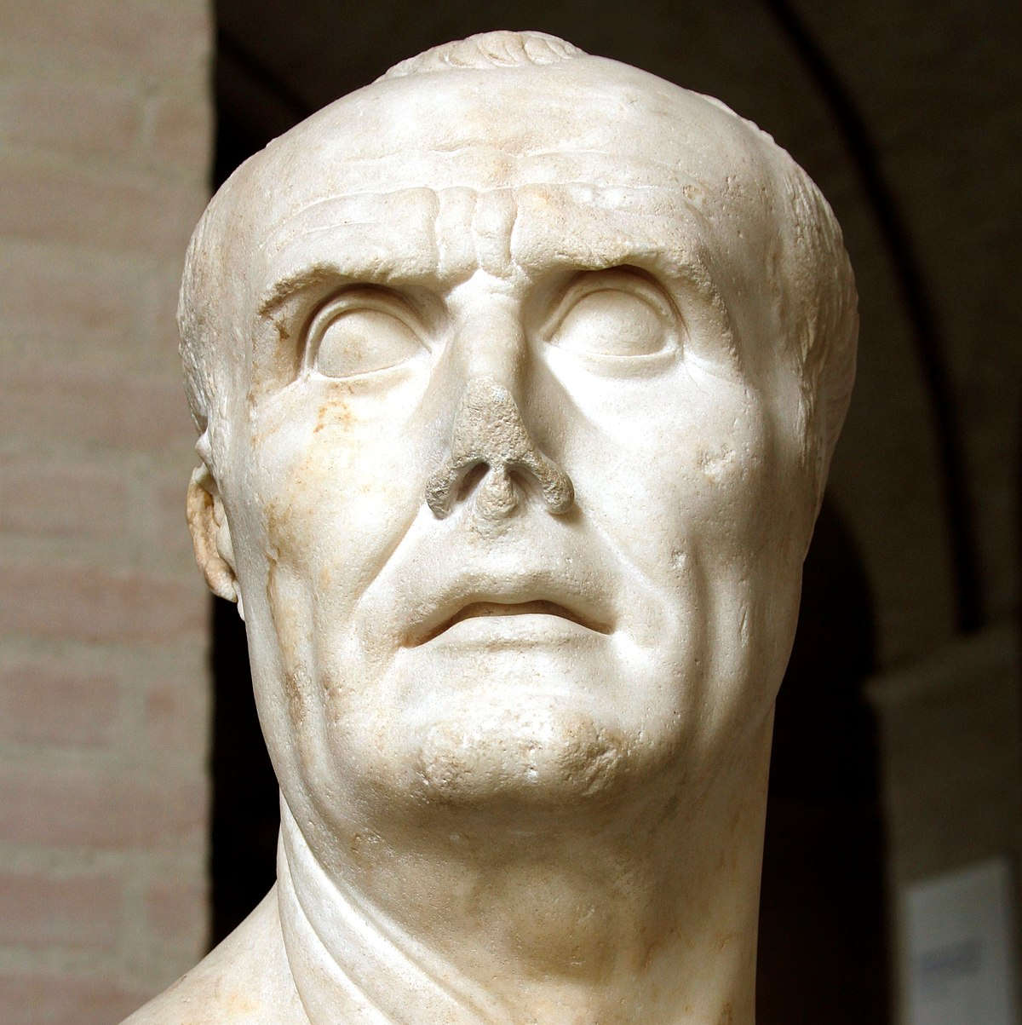
Source Analysis Prep
GOAL/S: Analyse historical sources –
Gaius Marius
Week 8, Lesson 1

Slide 2
This Week
Tuesday
SA PREP
Wednesday
SA PREP
Thursday
Task 2 Source Analysis

Slide 3

ACTIVITY 1 – Mind Map
As a class, will create a mind map about Gaius Marius.
This is to revise the CONTENT we have covered so far.
DISCUSSION QUESTIONS:
What is the difference between CONTENT and SKILLS?
What features does a GOOD mind map have?

Slide 4
Gaius Marius

Slide 5
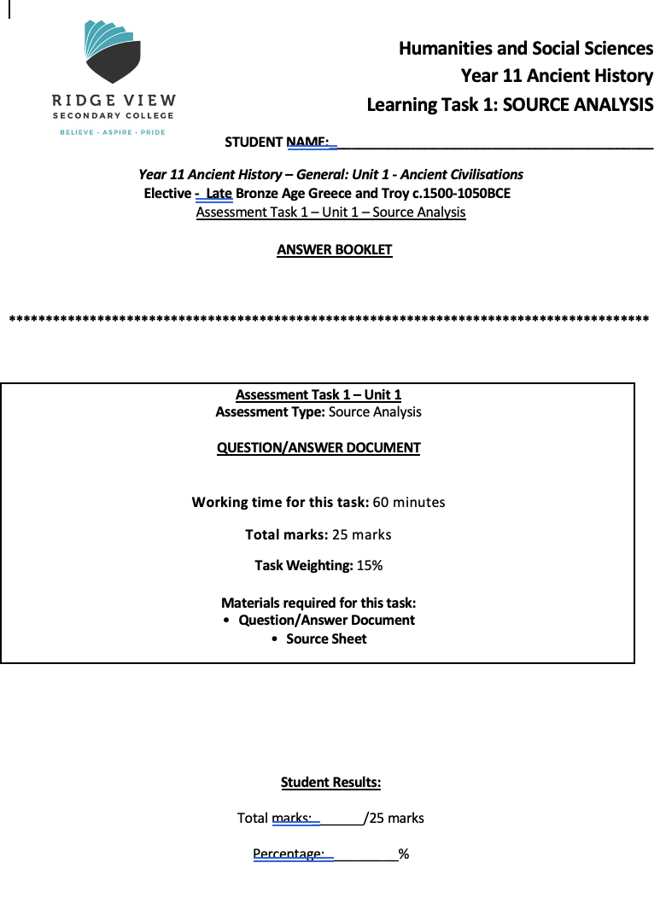
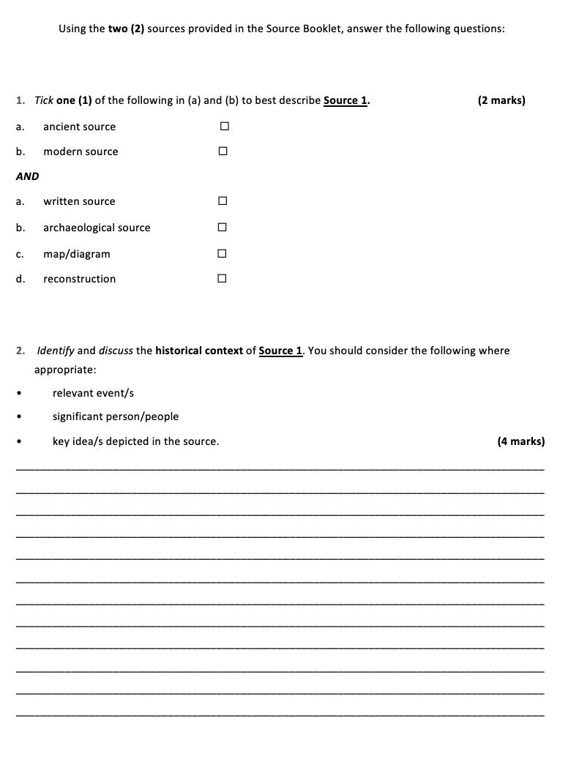
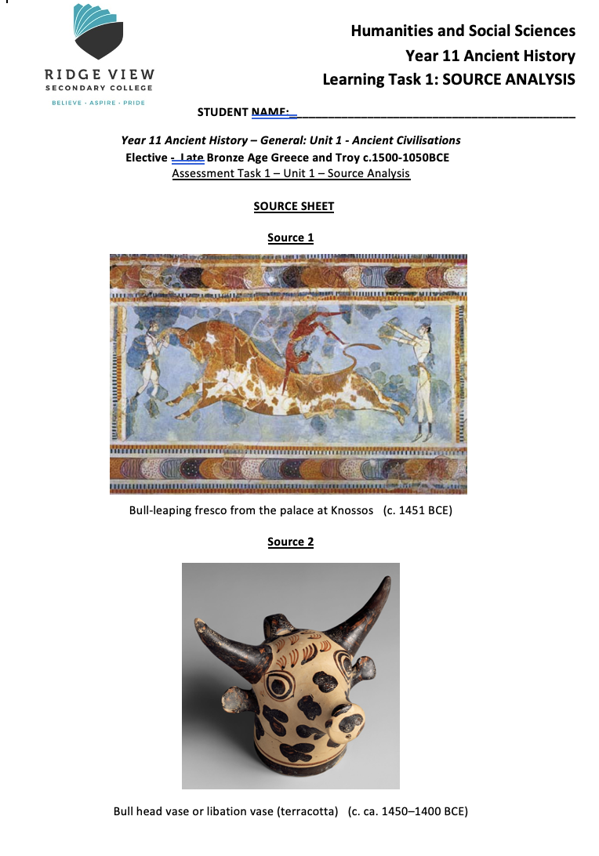
STEPS TO ANALYSING SOURCES
STEP 1 – Have a look through the Source Analysis in its entirety (1 - 2 min)

Slide 6
STEPS TO ANALYSING SOURCES
STEP 2 – Annotate the sources (1 – 2 minutes)

Slide 7
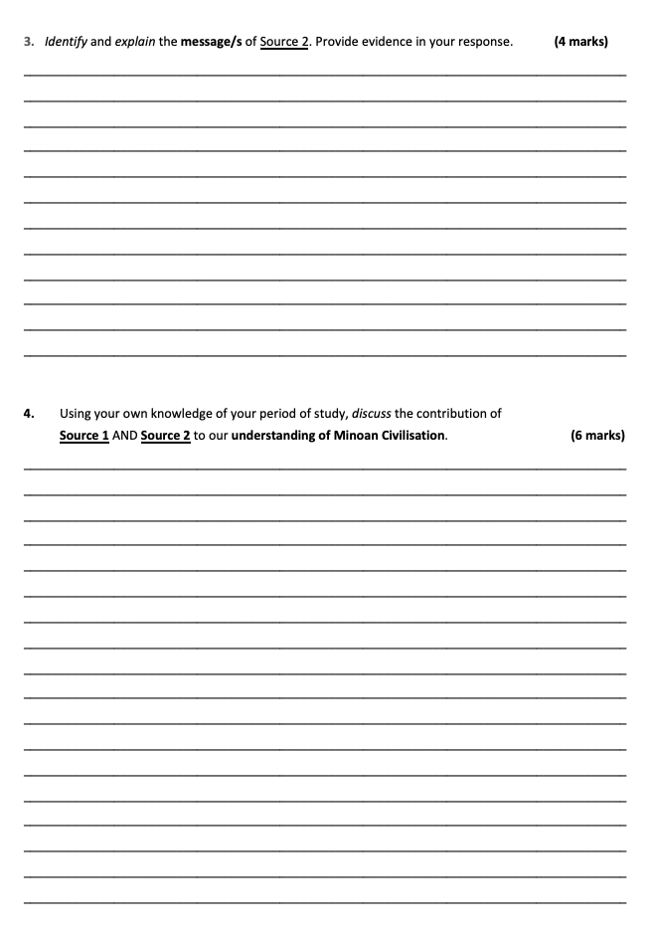
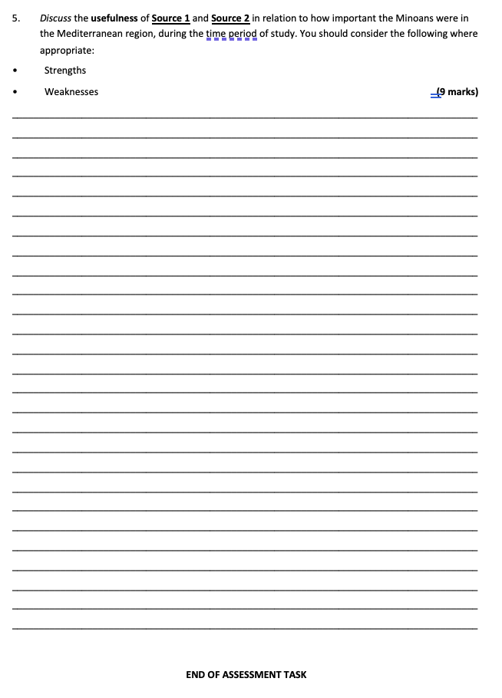
STEPS TO ANALYSING SOURCES
STEP 3 – Plan your questions (1 min)

Slide 8
STEPS TO ANALYSING SOURCES
STEP 4 – Answer your questions

Slide 9
STEPS TO ANALYSING SOURCES
STEP 5 – CHECK AND EDIT YOUR ANSWERS

Slide 10
The best Source Analysis answers will…
Use the question in their answer (e.g. “The historical context of Source 1 is…”)
Use formal language (NO I, we, you, our, things, stuff)
Be edited for spelling, grammar, and understanding (does it actually make sense?)
Have enough for the amount of marks – 4 marks = 4 good points!

Slide 11
The worst Source Analysis answers will…
Not be attempted (you lose marks!)
Use informal language (I think that…)
Not be edited
Not answer the question – don’t just write everything you know!

Slide 12

ACTIVITY – Overview Sheet
We will analyse each question in your upcoming Source Analysis test.
I will teach you HOW to answer each question, how many MARKS there are for each, and give you a GOOD sample answer (for a practice source).

Slide 13
Source Analysis Prep
GOAL/S: Analyse historical sources –
Gaius Marius
Week 8, Lesson 2

Slide 14

INSTRUCTIONS:
As a class, we will analyse and write responses using TWO (2) practice sources

